Slide 1
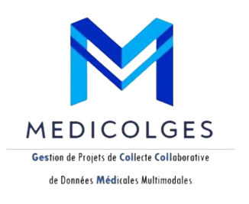




PIWEB
MediColGes
Creation and Management Platform
Collaborative Medical Data Collection Projects
Multimodal
Presentation by
NINJA’SCODE

Slide 2










NINJA’SCODE
Ninja’sCode , TWIN5
4TWIN 5
Asma Ayari
Amine Ben Rejeb
Coach
DEVELOPPER
Teacher at ESPRIT School of Engineering
Maha Messaoud
Wiem Hamdoun
Ahmed Ben Abid
Skander Chouk
DEVELOPPER
DEVELOPPER
DEVELOPPER
DEVELOPPER

Slide 3


Table of contents
1
Project context
6
ODD incorporated
Problematic
2
7
Technical requirements
Study of the existing
3
Prototype
8
4
Project Planification
Proposed Solution
9
5
Value and innovation

Slide 4




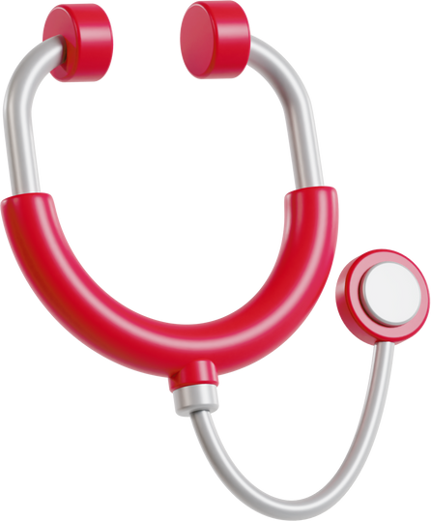
Aims and Objectives
Project context
To revolutionize the medical data management
Objectives:
Streamline the collection, management, and analysis of medical data.
Address coordination challenges in collaborative research projects.
Ensure secure sharing of sensitive medical information.

Slide 5



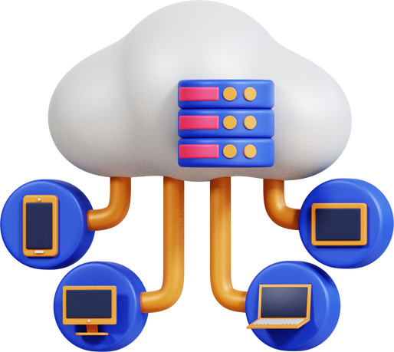
Problematic
How can MediColGes address medical data fragmentation, security, and accessibility barriers to transform healthcare data collection, management, and analysis?

Slide 6
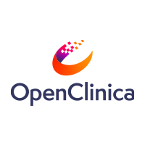




Study of the existing
1
OpenClinica is an open-source clinical data management platform used by researchers and clinicians to collect, manage, and analyze clinical data.
2
i2b2 is a clinical research platform used by researchers to collect, manage, and analyze clinical research data.
3
REDCap is an electronic data capture (EDC) platform used by researchers to collect and manage research data

Slide 7
Criticism of the existing
1
User Experience (UI/UX) : the user interface may not be as modern or intuitive as other newer software solutions
Cost and Accessibility
Limited Flexibility : the platform has limitations in terms of customization and adapting to very specific study protocols.
2
User Experience (UI/UX) : The user interface can appear dated and less intuitive compared to more modern solutions
Data Integration : Integrating data from different sources or formats can be complex
3
User Experience (UI/UX) : less engaging or intuitive compared to current web standards
Customization and Flexibility: While REDCap is quite flexible, there are some limitations in terms of form customization and interface adjustments

Slide 8



Proposed Solution
MediColGes is a medical data collection platform that aims to address the problems of data fragmentation, data privacy and security and data accessibility.
The platform allows researchers and healthcare professionals
to collect
manage
and analyze medical data
from a variety of sources, including hospitals, laboratoires and wearables.
MedicolGes

Slide 9
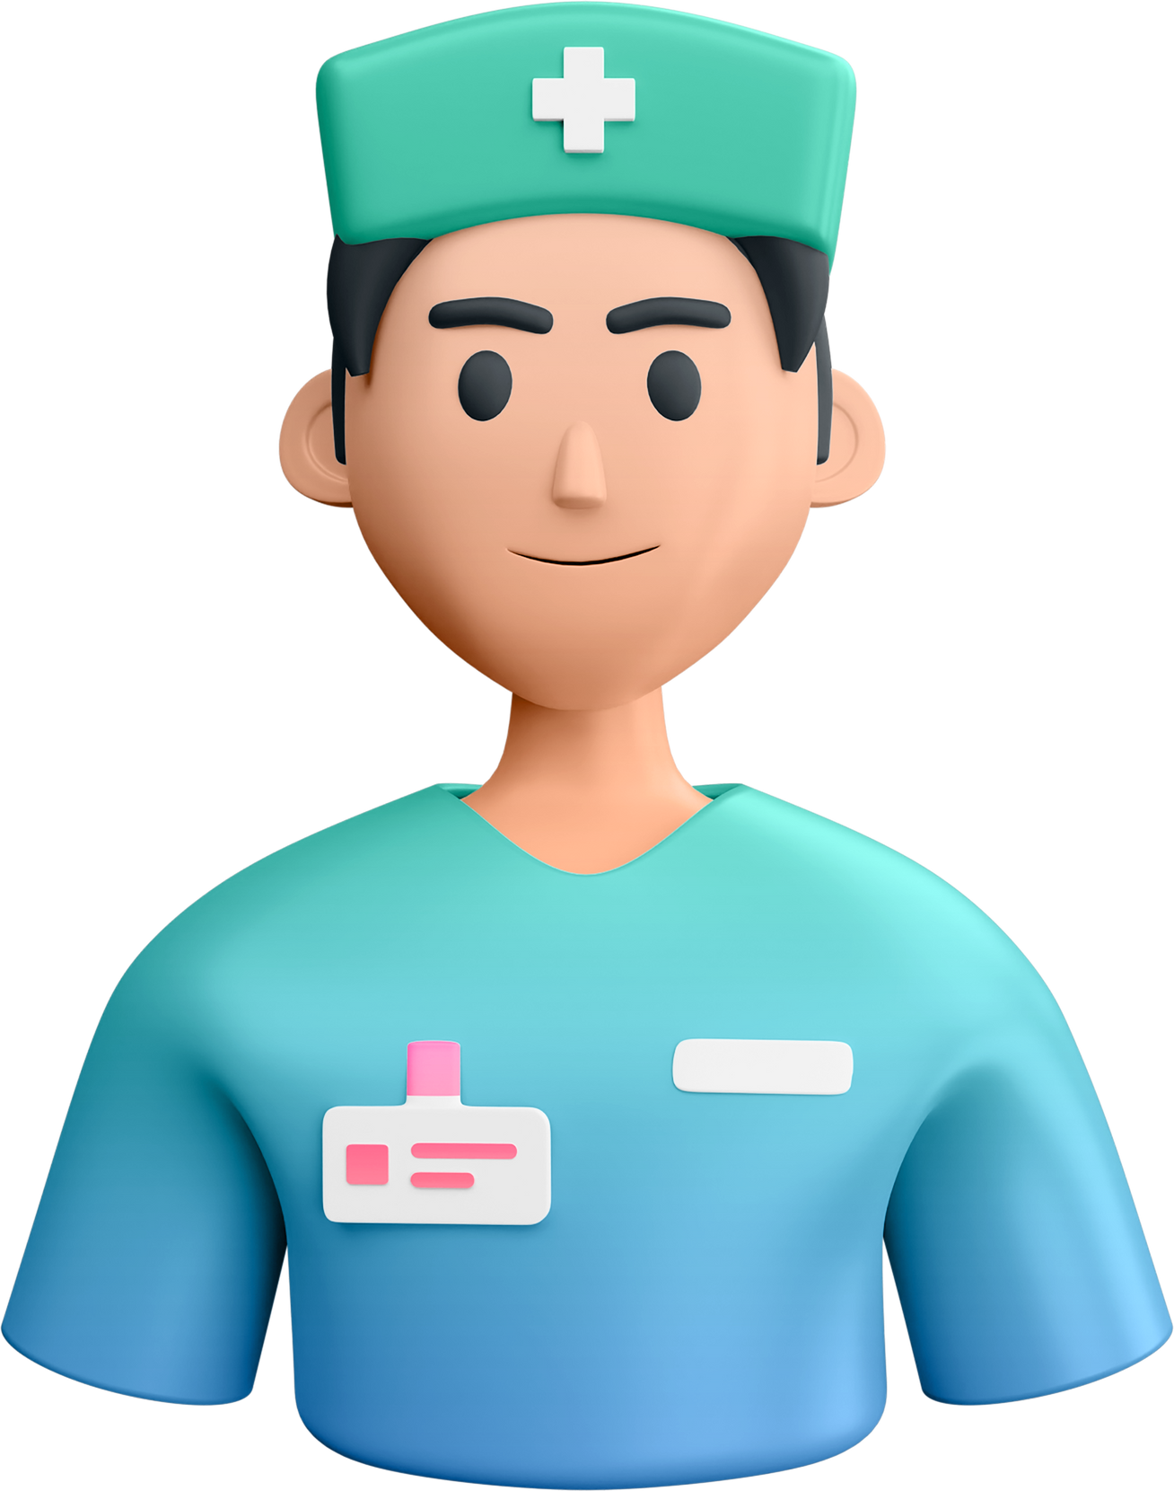

Added value and innovation
1
Strategy 1
Integration of data from different sources, such as hospitals, laboratories, and wearables.
Strategy 2
2
Use of artificial intelligence (AI) and machine learning (ML) for data analysis, anomaly detection, and recommendation generation

Slide 10
Added value and innovation
3
Strategy 3
Advanced collaboration features, such as Chat and real-time document sharing.
Strategy 4
4
Enhanced security and privacy features, in compliance with applicable standards and regulations
By integrating these features, MediColGes could offer a more comprehensive and innovative platform that meets the specific needs of researchers and healthcare professionals.

Slide 11




SDGs
The Sustainable Development Goals incorporated into the project
3
Good Health and Well-being
MediColGes aims to improve healthcare outcomes by streamlining medical data management and facilitating access to critical information for researchers and healthcare professionals.
Medical
9
Industry, Innovation, and Infrastructure
By leveraging innovative technologies such as AI and ML, MediColGes enhances infrastructure for data collection, analysis, and collaboration in the healthcare sector.

Slide 12

SDGs
The Sustainable Development Goals incorporated into the project
17
Partnerships for the Goals
Collaborative partnerships are integral to the success of MediColGes, as it brings together stakeholders from various sectors to work towards common objectives, fostering innovation and knowledge-sharing.
Medical
Our project's contribution to these SDGs underscores our commitment to sustainable development and improving the quality of life for communities worldwide.

Slide 13


Technical and functional requirements

Slide 14


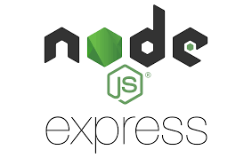
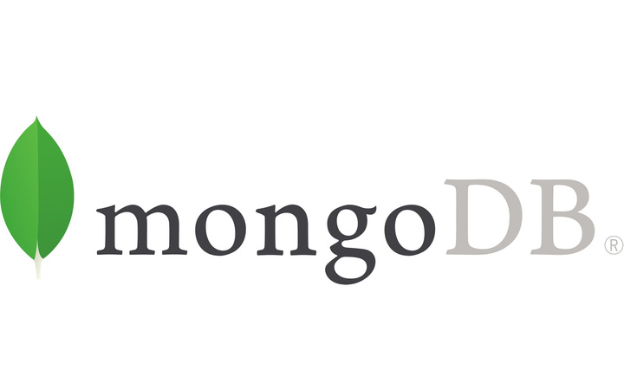
Frontend Technology
Framework: ReactJS
Libraries: Redux for state management, React Router for navigation
Backend Technology
Framework: Express.js for Node.js
API Design: RESTful API endpoints for data communication
Middleware: Use middleware for request processing, such as body parsing and logging
Database
Database: MongoDB
Data Modeling: Define schemas for structured storage of medical data
Technical requirements

Slide 15
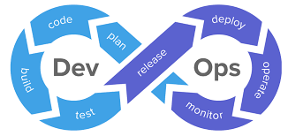

Technical requirements
Deployment:
Hosting: Deploy on cloud platforms
Containerization: Dockerize application components for consistency and portability
Continuous Integration/Continuous Deployment (CI/CD)
Backup and Disaster Recovery:
Regular Backups: Implement automated backup processes to ensure data integrity and availability
Disaster Recovery Plan: Develop and document procedures for recovering from system failures or data loss events

Slide 16


Security:
Safety requirements :
Data integrity and privacy
Error handling and prevention
System reliability and uptime
User-centered design
Security requirements :
Authentication and authorization
Encryption
Network security
Software quality attributes :
Scalability
Performance
Maintainability
Reliability
Technical requirements

Slide 17
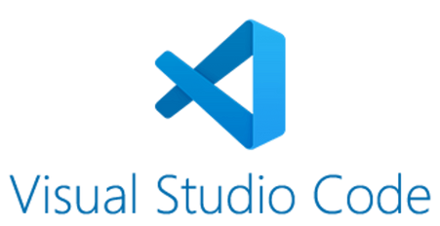
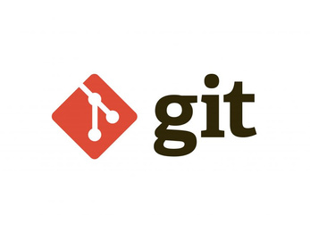

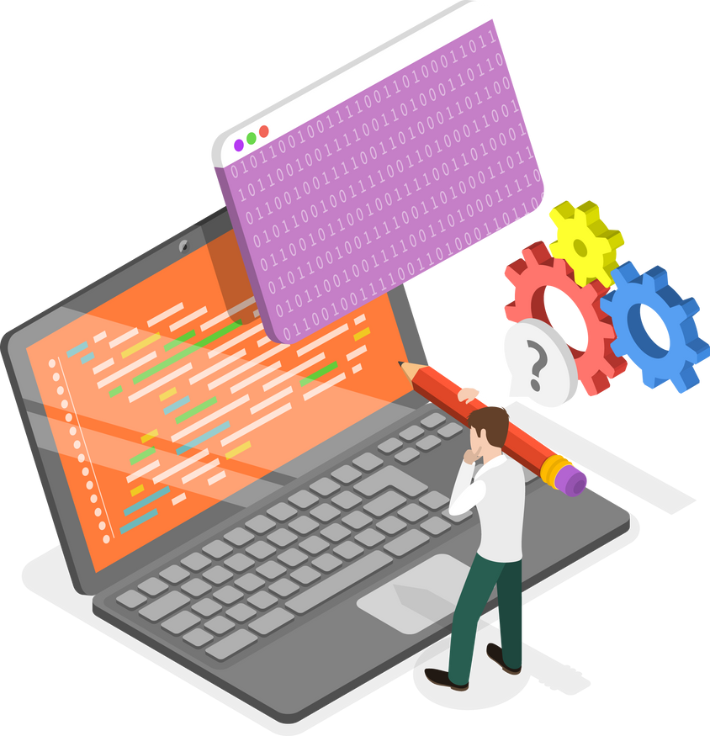
Technical requirements
Software tools :
Development: IDEs like Visual Studio Code
Version Control: Git, GitHub
Testing: Jest for JavaScript testing
DevOps Tools: Integrate continuous integration (CI) and continuous delivery (CD)

Slide 18



Functional requirements
Business features specification
Module 1: User Management
Module 2: Form Generation Management
Module 3: Data Import/Export
Module 4: Project Management
Submodule 4.1: Project Management
Submodule 4.2: Data Visualization and Analysis
Module 5: Collaboration Management
Submodule 5.1: Real-time Communication
Submodule 5.2: Collaborative Workspace
.
Module 6: Forum Management
Module 7: Feedback Management
Module 8: Team Management
Module 9: Establishment Management
Submodule 9.1: Healthcare Organizations
Submodule 9.2: Non-profit Organizations
Submodule 9.3: Pharmaceutical & Biomedical Industry
Module 10 : Questionnaire Management

Slide 19
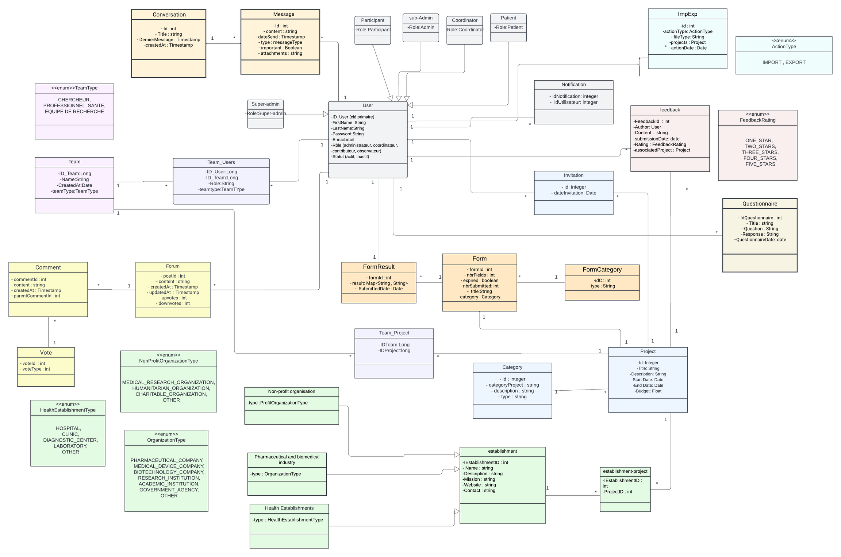

Class
diagram

Slide 20
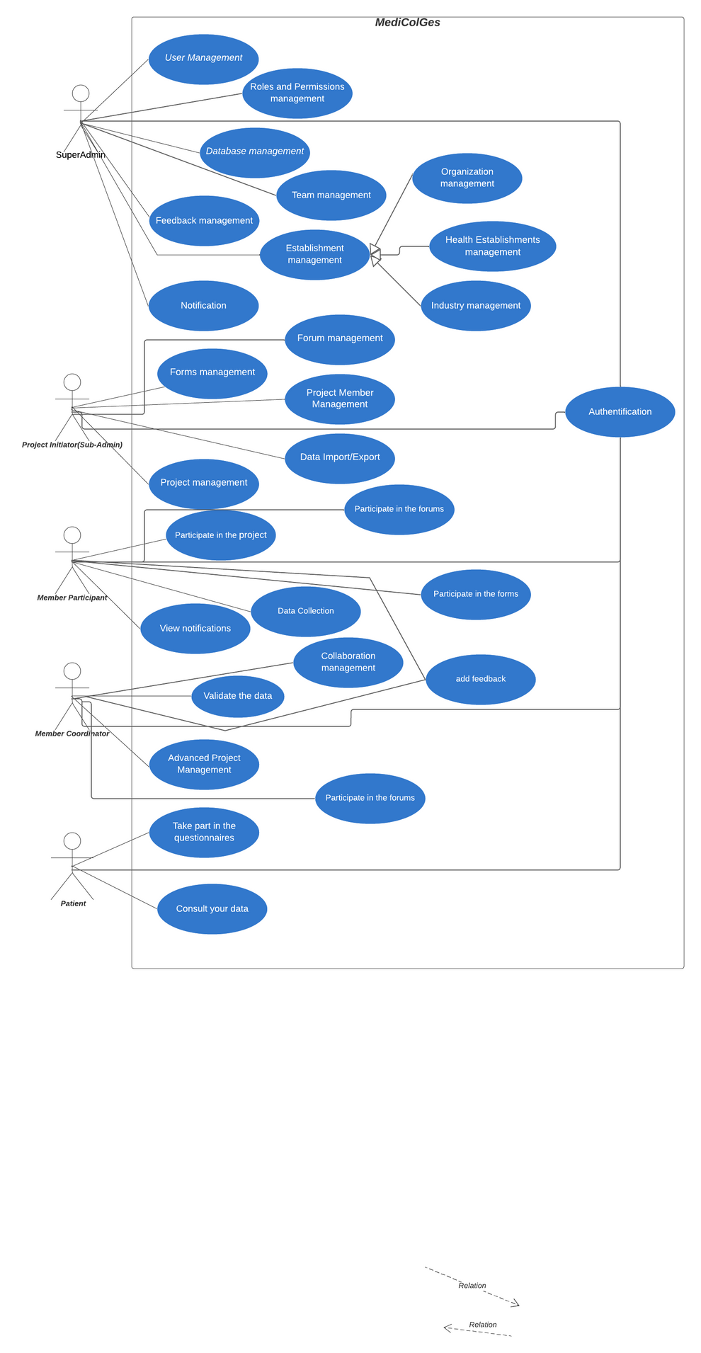

Functional requirements
Use case diagram

Slide 21

Prototype
Prototype

Slide 22
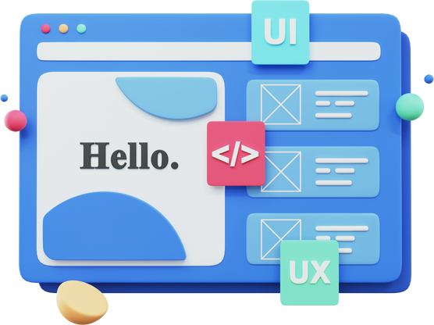
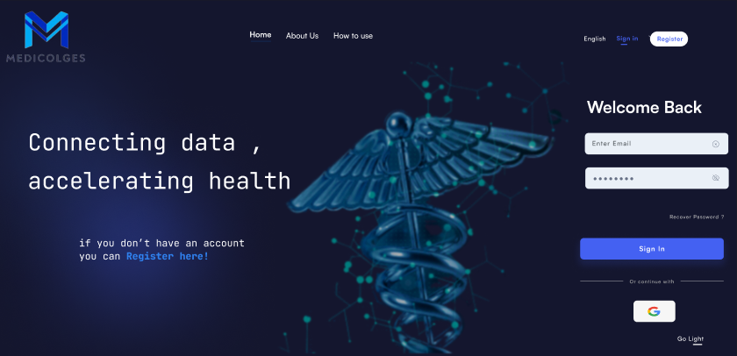

Prototype
HOME PAGE

Slide 23


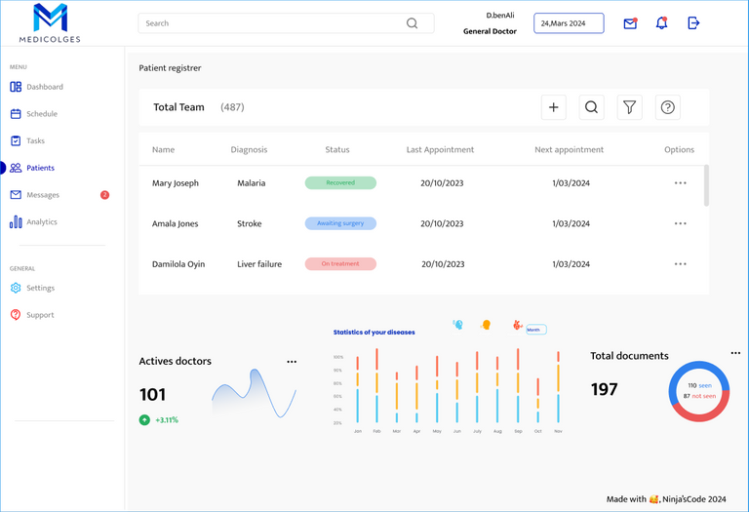
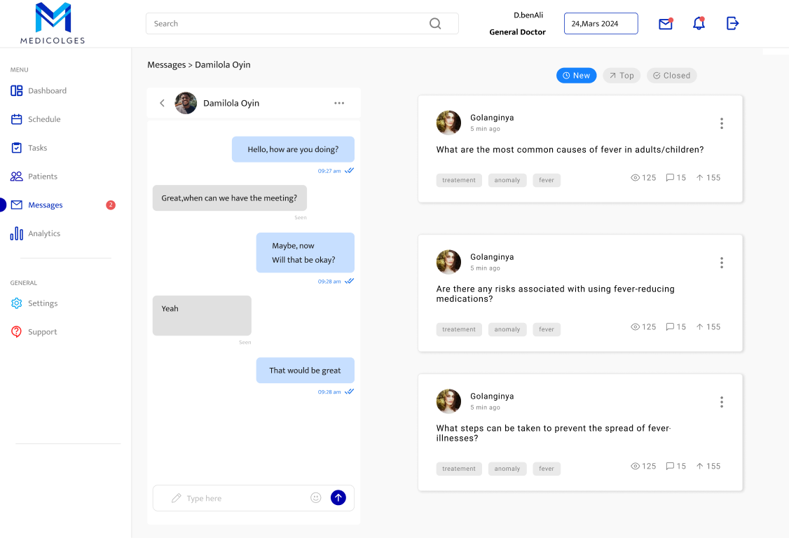
Prototype
BACK OFFICE PROTOTYPE

Slide 24
Planification
Project Planification

Slide 25
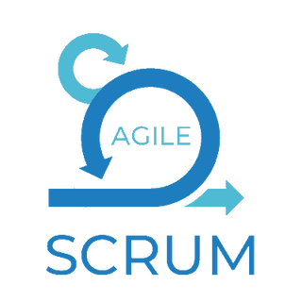

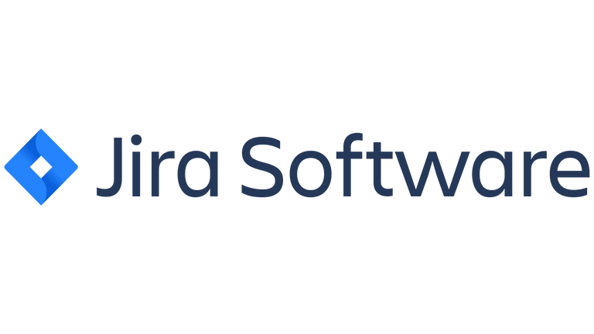
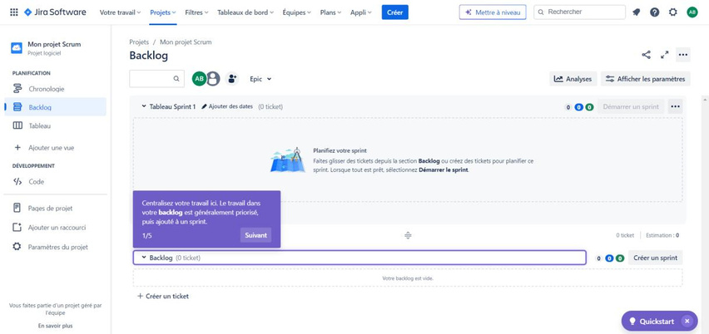
Project Planification
Development methodology:
We'll be employing Agile methodologies, specifically Scrum,
to stay flexible and collaborative during project development, adapting to changes efficiently to deliver value promptly.
Version Control
Collaboration
CI/CD Integration
Code Review
Project Management
Agile Development
Reporting
Collaboration

Slide 26
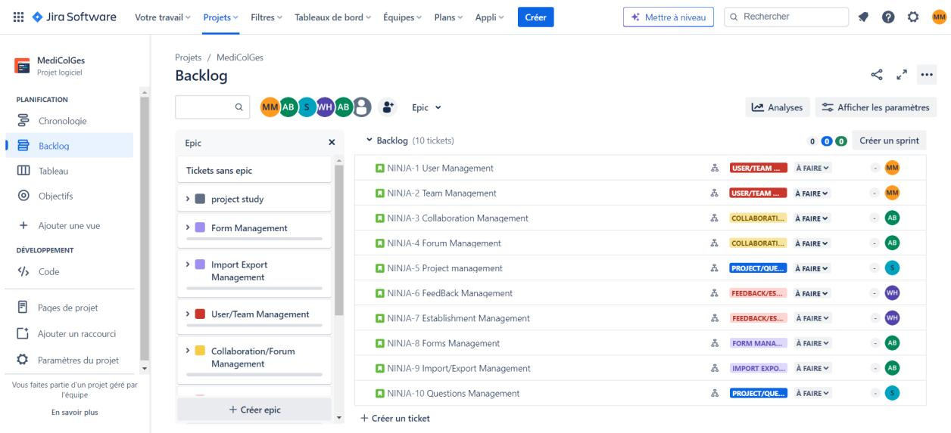
Project Planification
Product Backlog

Slide 27
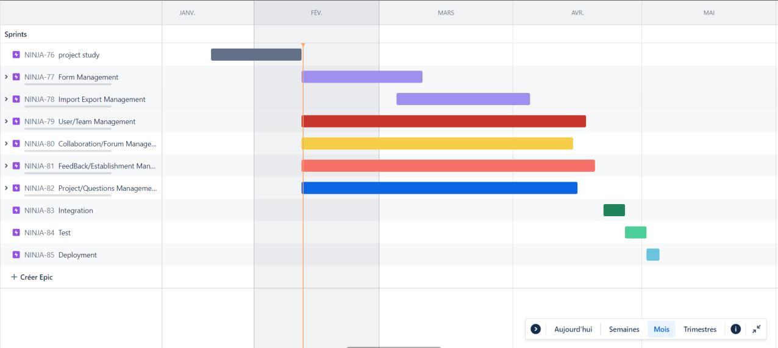

Project Planification
Gantt diagramme

Slide 28

Conclusion
In summary, "MediColGes" presents a cutting-edge solution for medical data management, leveraging advanced technologies to streamline processes and enhance collaboration among healthcare professionals. By addressing key challenges and aligning with Sustainable Development Goals, it aims to revolutionize healthcare research and patient care. With a commitment to excellence and innovation, "MediColGes" strives to make a lasting impact in the medical field, driving advancements and improving outcomes for patients worldwide.

Slide 29


Presented by
NINJA’SCODE
Thank You

Slide 30

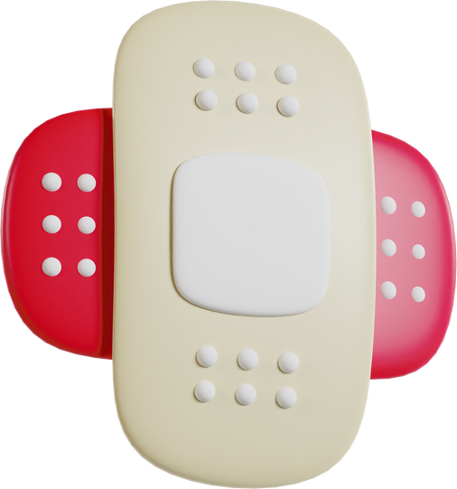
Question and Answer
Any questions ?

